Slide 1
Chapter 8
Case Study 1

Slide 2
Pairs Trading- finding pairs based on Clustering
In this case study, we will use clustering methods to select pairs for a pairs trading strategy.

Slide 3
Content
1. Problem Definition
2. Getting Started - Load Libraries and Dataset
2.1. Load Libraries
2.2. Load Dataset
3. Exploratory Data Analysis
3.1 Descriptive Statistics
3.2. Data Visualisation
4. Data Preparation
4.1 Data Cleaning
4.2.Data Transformation

Slide 4
Content
5. Evaluate Algorithms and Models
5.1. k-Means Clustering
5.1.1. Finding optimal number of clusters
5.1.2. Clustering and Visualization
5.2. Hierarchical Clustering (Agglomerative Clustering)
5.2.1. Building Hierarchy Graph/ Dendogram
5.2.2. Clustering and Visualisation
5.3. Affinity Propagation Clustering
5.3.1. Cluster Visualisation
5.4. Cluster Evaluation

Slide 5
Content
6. Pair Selection
6.1. Cointegration and Pair Selection Function
6.2. Pair Visualisation

Slide 6
1. Problem Definition

Slide 7
1. Problem Definition
Our goal in this case study is to perform clustering analysis on the stocks of S&P500 and come up with pairs for a pairs trading strategy.
The data of the stocks of S&P 500, are obtained using pandas_datareader from yahoo finance. It includes price data from 2018 onwards.

Slide 8
2. Getting Started - Loading the data and python packages

Slide 9
2.1. Loading the python packages
# Load libraries
import numpy as np
import pandas as pd
import matplotlib.pyplot as plt
from pandas import read_csv, set_option
from pandas.plotting import scatter_matrix
import seaborn as sns
from sklearn.preprocessing import StandardScaler
from tabulate import tabulate
import datetime
import pandas_datareader as dr

Slide 10
2.1. Loading the python packages
# Import Model Packages
from sklearn.cluster import KMeans, AgglomerativeClustering,AffinityPropagation, DBSCAN
from scipy.cluster.hierarchy import fcluster
from scipy.cluster.hierarchy import dendrogram, linkage, cophenet
from scipy.spatial.distance import pdist
from sklearn.metrics import adjusted_mutual_info_score
from sklearn import cluster, covariance, manifold

Slide 11
2.1. Loading the python packages
# Other Helper Packages and functions
import matplotlib.ticker as ticker
from itertools import cycle
# For printing tables
def pretty_print_df(df):
print(tabulate(df, headers='keys', tablefmt='psql', floatfmt='.3f'))

Slide 12
2.2. Loading the Data
# The data already obtained from yahoo finance is imported.
dataset = read_csv('SP500Data.csv',index_col=0)
# Disable the warnings
import warnings
warnings.filterwarnings('ignore')

Slide 13
3. Exploratory Data Analysis

Slide 14
3.1. Descriptive Statistics
# Print the dataset shape
print(f'Dataset shape: {dataset.shape}')
Sample output:
Dataset shape: (448, 502)

Slide 15
3.1. Descriptive Statistics
# peek at data
# set_option('display.width', 100)
pretty_print_df(dataset.head(5).iloc[:,:8])
Sample output:
+------------+--------+---------+---------+---------+--------+---------+--------+---------+
| Date | ABT | ABBV | ABMD | ACN | ATVI | ADBE | AMD | AAP |
|------------+--------+---------+---------+---------+--------+---------+--------+---------|
| 2018-01-02 | 58.790 | 98.410 | 192.490 | 153.840 | 64.310 | 177.700 | 10.980 | 106.090 |
| 2018-01-03 | 58.920 | 99.950 | 195.820 | 154.550 | 65.310 | 181.040 | 11.550 | 107.050 |
| 2018-01-04 | 58.820 | 99.380 | 199.250 | 156.380 | 64.660 | 183.220 | 12.120 | 111.000 |
| 2018-01-05 | 58.990 | 101.110 | 202.320 | 157.670 | 66.370 | 185.340 | 11.880 | 112.180 |
| 2018-01-08 | 58.820 | 99.490 | 207.800 | 158.930 | 66.630 | 185.040 | 12.280 | 111.390 |
+------------+--------+---------+---------+---------+--------+---------+--------+---------+

Slide 16
3.1. Descriptive Statistics
# describe data
# set_option('precision', 3)
pretty_print_df(dataset.describe().iloc[:,:8])
Sample output:
+-------+---------+---------+---------+---------+---------+---------+---------+---------+
| | ABT | ABBV | ABMD | ACN | ATVI | ADBE | AMD | AAP |
|-------+---------+---------+---------+---------+---------+---------+---------+---------|
| count | 448.000 | 448.000 | 448.000 | 448.000 | 448.000 | 448.000 | 448.000 | 448.000 |
| mean | 70.934 | 88.078 | 307.304 | 167.474 | 59.631 | 252.271 | 21.805 | 147.501 |
| std | 9.016 | 13.481 | 71.990 | 14.635 | 13.119 | 29.001 | 7.425 | 21.095 |
| min | 56.270 | 62.980 | 159.310 | 133.670 | 40.110 | 177.700 | 9.530 | 103.760 |
| 25% | 62.620 | 78.658 | 260.557 | 157.280 | 47.038 | 235.377 | 15.147 | 133.307 |
| 50% | 70.015 | 88.525 | 301.940 | 162.880 | 55.270 | 254.685 | 21.885 | 154.950 |
| 75% | 78.620 | 96.667 | 368.095 | 178.338 | 71.565 | 272.990 | 28.438 | 163.615 |
| max | 88.740 | 123.210 | 449.750 | 201.120 | 83.390 | 311.270 | 34.390 | 184.720 |
+-------+---------+---------+---------+---------+---------+---------+---------+---------+

Slide 17
3.2. Data Visualization
We will take a detailed look into the visualization post clustering.

Slide 18
4. Data Preparation

Slide 19
4.1. Data Cleaning
We check for the NAs in the rows, either drop them or fill them with the last value of the column.

Slide 20
4.1. Data Cleaning
# Checking for any null values and removing the null values'''
print('Null Values =',dataset.isnull().values.any())
Sample output:
Null Values = True

Slide 21
4.1. Data Cleaning
# Getting rid of the columns with more than 30% missing values.
missing_fractions = dataset.isnull().mean().sort_values(ascending=False)
print(missing_fractions.head(10))
Sample output:
CTVA 0.781250
DOW 0.678571
FOX 0.667411
FOXA 0.665179
NOV 0.000000
MSI 0.000000
MSCI 0.000000
MYL 0.000000
NDAQ 0.000000
ABT 0.000000
dtype: float64

Slide 22
4.1. Data Cleaning
drop_list = sorted(list(missing_fractions[missing_fractions > 0.3].index))
dataset.drop(labels=drop_list, axis=1, inplace=True)
print(f'Dataset shape: {dataset.shape}')
Sample output:
Dataset shape: (448, 498)

Slide 23
4.1. Data Cleaning
# Given that there are null values drop the row containing the null values.
# Fill the missing values with the last value available in the dataset.
dataset=dataset.fillna(method='ffill')
pretty_print_df(dataset.head(2).iloc[:,:8])
Sample output:
+------------+--------+--------+---------+---------+--------+---------+--------+---------+
| Date | ABT | ABBV | ABMD | ACN | ATVI | ADBE | AMD | AAP |
|------------+--------+--------+---------+---------+--------+---------+--------+---------|
| 2018-01-02 | 58.790 | 98.410 | 192.490 | 153.840 | 64.310 | 177.700 | 10.980 | 106.090 |
| 2018-01-03 | 58.920 | 99.950 | 195.820 | 154.550 | 65.310 | 181.040 | 11.550 | 107.050 |
+------------+--------+--------+---------+---------+--------+---------+--------+---------+

Slide 24
4.2. Data Transformation
For the purpose of clustering, we will be using annual returns and variance as the variables as they are the indicators of the stock performance and its volatility. Let us prepare the return and volatility variables from the data.

Slide 25
4.2. Data Transformation
# Calculate average annual percentage return and volatilities over a
# theoretical one year period
returns = dataset.pct_change().mean() * 252
returns = pd.DataFrame(returns)
returns.columns = ['Returns']
returns['Volatility'] = dataset.pct_change().std() * np.sqrt(252)
data = returns

Slide 26
4.2. Data Transformation
All the variables should be on the same scale before applying clustering, otherwise a feature with large values will dominate the result. We use StandardScaler in sklearn to standardize the dataset’s features onto unit scale (mean = 0 and variance = 1).

Slide 27
4.2. Data Transformation
from sklearn.preprocessing import StandardScaler
scaler = StandardScaler().fit(data)
rescaledDataset = pd.DataFrame(scaler.fit_transform(data),
columns = data.columns, index = data.index)
# summarize transformed data
X = rescaledDataset
pretty_print_df(X.head(2))
Sample output:
+------+-----------+--------------+
| | Returns | Volatility |
|------+-----------+--------------|
| ABT | 0.794 | -0.703 |
| ABBV | -0.928 | 0.795 |
+------+-----------+--------------+

Slide 28
4.2. Data Transformation
The parameters to clusters are the indices and the variables used in the clustering are the columns. Hence the data is in the right format to be fed to the clustering algorithms.

Slide 29
5. Evaluate Algorithms and Models

Slide 30
We will look at the following models:
1. KMeans
2. Hierarchical Clustering (Agglomerative Clustering)
3. Affinity Propagation

Slide 31
5.1. K-Means Clustering
5.1.1. Finding optimal number of clusters
In this step we look at the following metrices:
1. Sum of square errors (SSE) within clusters
2. Silhouette score.

Slide 32
5.1.1. Finding optimal number of clusters
distorsions = []
max_loop=20
for k in range(2, max_loop):
kmeans = KMeans(n_clusters=k)
kmeans.fit(X)
distorsions.append(kmeans.inertia_)
fig = plt.figure(figsize=(15, 5))
plt.plot(range(2, max_loop), distorsions)
plt.xticks([i for i in range(2, max_loop)], rotation=75)
plt.grid(True)
plt.show()

Slide 33
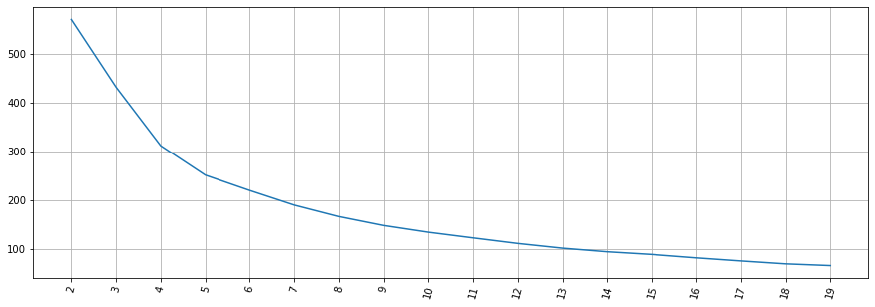
Inspecting the sum of squared errors chart, it appears the elbow “kink” occurs 5 or 6 clusters for this data. Certainly, we can see that as the number of clusters increase pass 6, the sum of square of errors within clusters plateaus off.

Slide 34
5.1.1. Finding optimal number of clusters
# #### Silhouette score
from sklearn import metrics
silhouette_score = []
for k in range(2, max_loop):
kmeans = KMeans(n_clusters=k, random_state=10, n_init=10)
kmeans.fit(X)
silhouette_score.append(metrics.silhouette_score(X, kmeans.labels_, random_state=10))
fig = plt.figure(figsize=(15, 5))
plt.plot(range(2, max_loop), silhouette_score)
plt.xticks([i for i in range(2, max_loop)], rotation=75)
plt.grid(True)
plt.show()

Slide 35
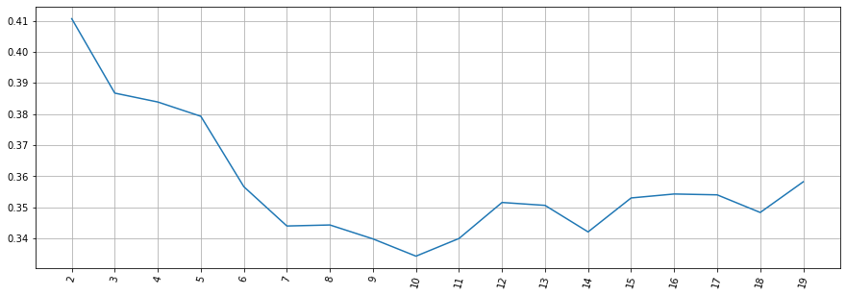
From the silhouette score chart, we can see that there are various parts of the graph where a kink can be seen. Since there is not much a difference in SSE after 6 clusters, we would prefer 6 clusters in the K-means model.

Slide 36
5.1. K-Means Clustering
5.1.2. Clustering and Visualisation
Let us build the k-means model with six clusters and visualize the results.

Slide 37
5.1.2. Clustering and Visualisation
nclust=6
# Fit with k-means
k_means = cluster.KMeans(n_clusters=nclust)
k_means.fit(X)
# Extracting labels
target_labels = k_means.predict(X)

Slide 38
5.1.2. Clustering and Visualisation
Visualizing how your clusters are formed is no easy task when the number of variables/dimensions in your dataset is very large. One of the methods of visualising a cluster in two-dimensional space.

Slide 39
5.1.2. Clustering and Visualisation
centroids = k_means.cluster_centers_
fig = plt.figure(figsize=(16,10))
ax = fig.add_subplot(111)
scatter = ax.scatter(X.iloc[:,0],X.iloc[:,1], c = k_means.labels_,
cmap ="rainbow", label = X.index)
ax.set_title('k-Means results')
ax.set_xlabel('Mean Return')
ax.set_ylabel('Volatility')
plt.colorbar(scatter)
plt.plot(centroids[:,0],centroids[:,1],'sg',markersize=11)
plt.show()

Slide 40
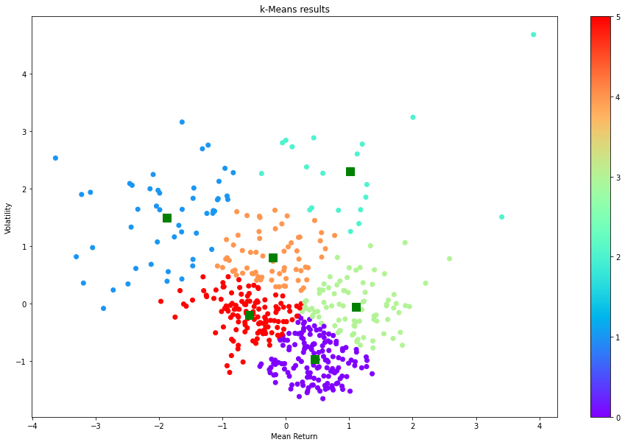

Slide 41
5.1.2. Clustering and Visualisation
# Let us check the elements of the clusters
# show number of stocks in each cluster
clustered_series = pd.Series(index=X.index, data=k_means.labels_.flatten())
# clustered stock with its cluster label
clustered_series_all = pd.Series(index=X.index, data=k_means.labels_.flatten())
clustered_series = clustered_series[clustered_series != -1]
plt.figure(figsize=(12,7))
plt.barh(
range(len(clustered_series.value_counts())), # cluster labels, y axis
clustered_series.value_counts()
)
plt.title('Cluster Member Counts')
plt.xlabel('Stocks in Cluster')
plt.ylabel('Cluster Number')
plt.show()

Slide 42
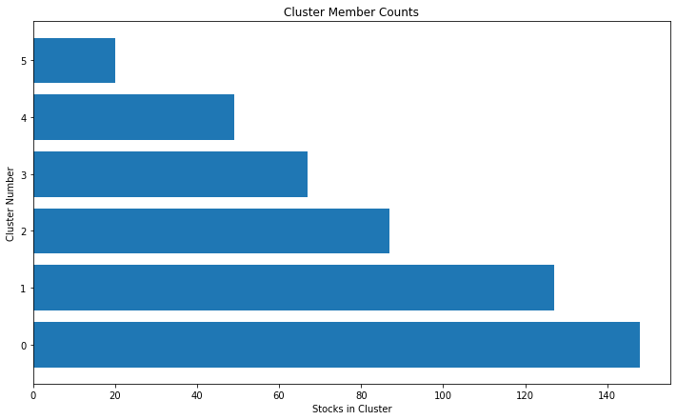
The number of stocks in a cluster range from around 40 to 120. Although, the distribution is not equal, we have significant number of stocks in each cluster.

Slide 43
5.2. Hierarchical Clustering (Agglomerative Clustering)
In the first step we look at the hierarchy graph and check for the number of clusters.

Slide 44
5.2.1. Building Hierarchy Graph/ Dendogram
The hierarchy class has a dendrogram method which takes the value returned by the linkage method of the same class. The linkage method takes the dataset and the method to minimize distances as parameters. We use 'ward' as the method since it minimizes then variants of distances between the clusters.

Slide 45
5.2.1. Building Hierarchy Graph/ Dendogram
# Calulate linkage
Z= linkage(X, method='ward')
print(Z[0])
Sample output:
[3.30000000e+01 3.14000000e+02 3.62580431e-03 2.00000000e+00]

Slide 46
5.2.1. Building Hierarchy Graph/ Dendogram
The best way to visualize an agglomerate clustering algorithm is through a dendogram, which displays a cluster tree, the leaves being the individual stocks and the root being the final single cluster. The "distance" between each cluster is shown on the y-axis, and thus the longer the branches are, the less correlated two clusters are.

Slide 47
5.2.1. Building Hierarchy Graph/ Dendogram
# Plot Dendogram
plt.figure(figsize=(10, 7))
plt.title("Stocks Dendrograms")
dendrogram(Z,labels = X.index)
plt.show()

Slide 48
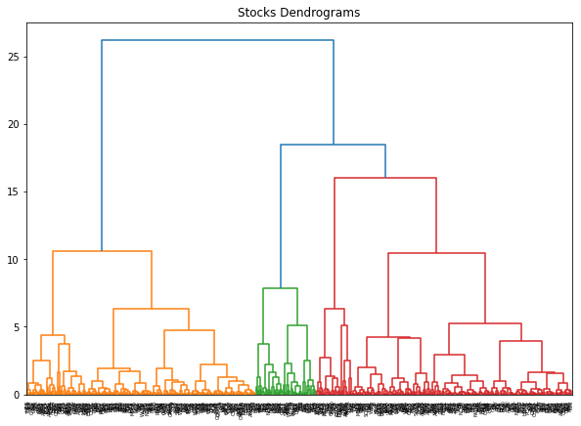

Slide 49
5.2.1. Building Hierarchy Graph/ Dendogram
Once one big cluster is formed, the longest vertical distance without any horizontal line passing through it is selected and a horizontal line is drawn through it. The number of vertical lines this newly created horizontal line passes is equal to number of clusters.

Slide 50
5.2.1. Building Hierarchy Graph/ Dendogram
Then we select the distance threshold to cut the dendrogram to obtain the selected clustering level. The output is the cluster labelled for each row of data. As expected from the dendrogram, a cut at 13 gives us four clusters.

Slide 51
5.2.1. Building Hierarchy Graph/ Dendogram
distance_threshold = 13
clusters = fcluster(Z, distance_threshold, criterion='distance')
chosen_clusters = pd.DataFrame(data=clusters, columns=['cluster'])
print(chosen_clusters['cluster'].unique())
Sample output:
[1 4 3 2]

Slide 52
5.2.2. Clustering and Visualisation
nclust = 4
hc = AgglomerativeClustering(n_clusters=nclust, affinity = 'euclidean', linkage = 'ward')
clust_labels1 = hc.fit_predict(X)
fig = plt.figure(figsize=(16,10))
ax = fig.add_subplot(111)
scatter = ax.scatter(X.iloc[:,0],X.iloc[:,1], c =clust_labels1, cmap ="rainbow")
ax.set_title('Hierarchical Clustering')
ax.set_xlabel('Mean Return')
ax.set_ylabel('Volatility')
plt.colorbar(scatter)
plt.show()

Slide 53
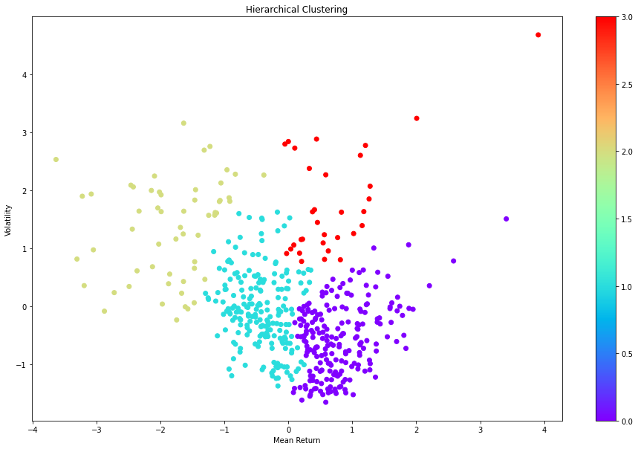
Similar to the plot of k-means clustering, we see that there are some distinct clusters separated by different colors.

Slide 54
5.3. Affinity Propagation Clustering
ap = AffinityPropagation()
ap.fit(X)
clust_labels2 = ap.predict(X)
fig = plt.figure(figsize=(10,8))
ax = fig.add_subplot(111)
scatter = ax.scatter(X.iloc[:,0],X.iloc[:,1], c =clust_labels2, cmap ="rainbow")
ax.set_title('Affinity')
ax.set_xlabel('Mean Return')
ax.set_ylabel('Volatility')
plt.colorbar(scatter)
plt.show()

Slide 55
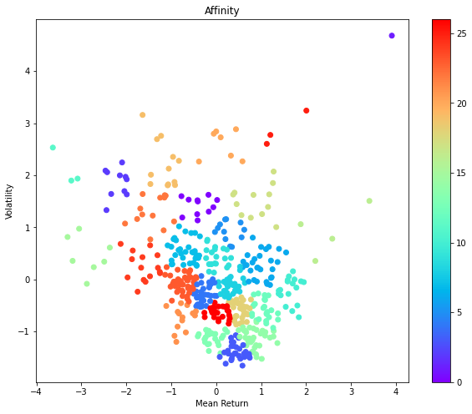
Similar to the plot of k-means clustering, we see that there are some distinct clusters separated by different colors.

Slide 56
5.3.1 Cluster Visualisation
cluster_centers_indices = ap.cluster_centers_indices_
labels = ap.labels_
no_clusters = len(cluster_centers_indices)
print('Estimated number of clusters: %d' % no_clusters)
Sample output:
Estimated number of clusters: 27

Slide 57
5.3.1 Cluster Visualisation
# Plot exemplars
X_temp=np.asarray(X)
fig = plt.figure(figsize=(8,6))
colors = cycle('bgrcmykbgrcmykbgrcmykbgrcmyk')
for k, col in zip(range(no_clusters), colors):
class_members = labels == k
cluster_center = X_temp[cluster_centers_indices[k]]
plt.plot(X_temp[class_members, 0], X_temp[class_members, 1], col + '.')
plt.plot(cluster_center[0], cluster_center[1], 'o', markerfacecolor=col,
markeredgecolor='k', markersize=14)
for x in X_temp[class_members]:
plt.plot([cluster_center[0], x[0]], [cluster_center[1], x[1]], col)
plt.show()

Slide 58
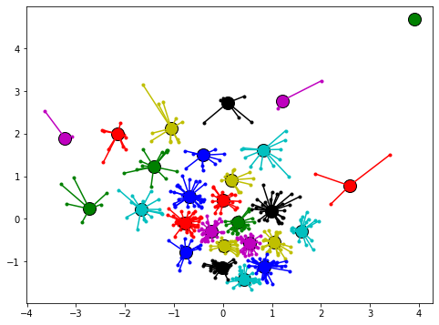

Slide 59
5.3.1 Cluster Visualisation
# show number of stocks in each cluster
clustered_series_ap = pd.Series(index=X.index, data=ap.labels_.flatten())
# clustered stock with its cluster label
clustered_series_all_ap = pd.Series(index=X.index, data=ap.labels_.flatten())
clustered_series_ap = clustered_series_ap[clustered_series != -1]
plt.figure(figsize=(12,7))
plt.barh(
range(len(clustered_series_ap.value_counts())), # cluster labels, y axis
clustered_series_ap.value_counts()
)
plt.title('Cluster Member Counts')
plt.xlabel('Stocks in Cluster')
plt.ylabel('Cluster Number')
plt.show()

Slide 60
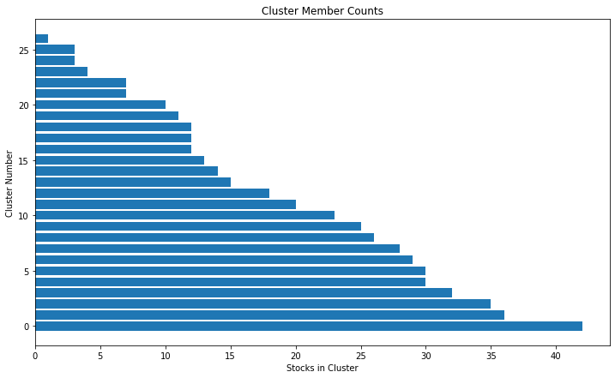

Slide 61
5.4. Cluster Evaluation
If the ground truth labels are not known, evaluation must be performed using the model itself. The Silhouette Coefficient (sklearn.metrics.silhouette_score) is an example of such an evaluation, where a higher Silhouette Coefficient score relates to a model with better defined clusters. The Silhouette Coefficient is defined for each sample and is composed of two scores:

Slide 62
5.4. Cluster Evaluation
from sklearn import metrics
print("km", metrics.silhouette_score(X, k_means.labels_, metric='euclidean'))
print("hc", metrics.silhouette_score(X, hc.fit_predict(X), metric='euclidean'))
print("ap", metrics.silhouette_score(X, ap.labels_, metric='euclidean'))
Sample output:
km 0.3355854288428007
hc 0.34321495156408627
ap 0.3450647315156527
We go ahead with the affinity propagation and use 27 clusters as specified by this clustering method

Slide 63
5.4. Cluster Evaluation
# ### Visualising the return within a cluster
# The understand the intuition behind clustering, let us visualize the results
# of the clusters.
# all stock with its cluster label (including -1)
clustered_series = pd.Series(index=X.index, data=ap.fit_predict(X).flatten())
# clustered stock with its cluster label
clustered_series_all = pd.Series(index=X.index, data=ap.fit_predict(X).flatten())
clustered_series = clustered_series[clustered_series != -1]
# get the number of stocks in each cluster
counts = clustered_series_ap.value_counts()
Sample output:

Slide 64
5.4. Cluster Evaluation
# let's visualize some clusters
cluster_vis_list = list(counts[(counts<25) & (counts>1)].index)[::-1]
print(cluster_vis_list)
Sample output:
[25, 11, 16, 20, 15, 2, 0, 19, 17, 5, 22, 21, 24, 10, 9, 13]

Slide 65
5.4. Cluster Evaluation
CLUSTER_SIZE_LIMIT = 9999
counts = clustered_series.value_counts()
ticker_count_reduced = counts[(counts>1) & (counts<=CLUSTER_SIZE_LIMIT)]
print ("Clusters formed: %d" % len(ticker_count_reduced))
print ("Pairs to evaluate: %d" % (ticker_count_reduced*(ticker_count_reduced-1)).sum())
Sample output:
Clusters formed: 26
Pairs to evaluate: 12166

Slide 66
5.4. Cluster Evaluation
# plot a handful of the smallest clusters
print(cluster_vis_list[0:min(len(cluster_vis_list), 4)])
Sample output:
[25, 11, 16, 20]

Slide 67
5.4. Cluster Evaluation
for clust in cluster_vis_list[0:min(len(cluster_vis_list), 4)]:
tickers = list(clustered_series[clustered_series==clust].index)
means = np.log(dataset.loc[:"2018-02-01", tickers].mean())
data = np.log(dataset.loc[:"2018-02-01", tickers]).sub(means)
data.plot(title='Stock Time Series for Cluster %d' % clust)
plt.show()

Slide 68
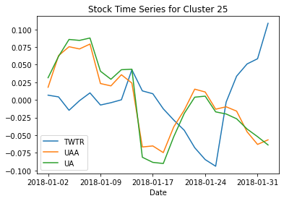

Slide 69
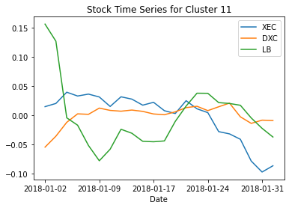

Slide 70
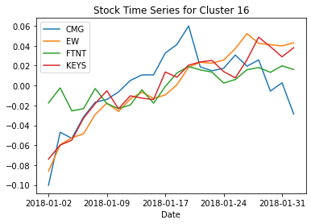

Slide 71
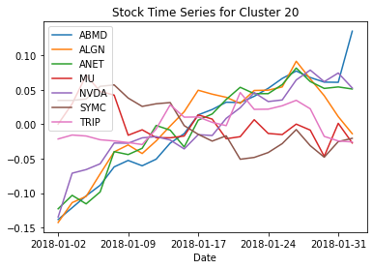

Slide 72
5.4. Cluster Evaluation
Looking at the charts above, across all the clusters with small number of stocks, we see similar movement of the stocks under different clusters, which corroborates the effectiveness of the clustering technique.

Slide 73
6. Pairs Selection

Slide 74
6.1. Cointegration and Pair Selection Function
def find_cointegrated_pairs(data, significance=0.05):
# This function is from https://www.quantopian.com/lectures/introduction-to-pairs-trading
n = data.shape[1]
score_matrix = np.zeros((n, n))
pvalue_matrix = np.ones((n, n))
keys = data.keys()
pairs = []
for i in range(1):
for j in range(i+1, n):
S1, S2 = data[keys[i]], data[keys[j]]
result = coint(S1, S2)
score = result[0]
pvalue = result[1]
score_matrix[i, j] = score
pvalue_matrix[i, j] = pvalue
if pvalue < significance:
pairs.append((keys[i], keys[j]))
return score_matrix, pvalue_matrix, pairs

Slide 75
6.1. Cointegration and Pair Selection Function
from statsmodels.tsa.stattools import coint
cluster_dict = {}
for i, which_clust in enumerate(ticker_count_reduced.index):
tickers = clustered_series[clustered_series == which_clust].index
score_matrix, pvalue_matrix, pairs = find_cointegrated_pairs(
dataset[tickers]
)
cluster_dict[which_clust] = {}
cluster_dict[which_clust]['score_matrix'] = score_matrix
cluster_dict[which_clust]['pvalue_matrix'] = pvalue_matrix
cluster_dict[which_clust]['pairs'] = pairs
pairs = []
for clust in cluster_dict.keys():
pairs.extend(cluster_dict[clust]['pairs'])
print ("Number of pairs found : %d" % len(pairs))
print ("In those pairs, there are %d unique tickers." % len(np.unique(pairs)))
print(pairs)

Slide 76
6.1. Cointegration and Pair Selection Function
Sample output:
Number of pairs found : 32
In those pairs, there are 47 unique tickers.
[('AOS', 'FITB'), ('AOS', 'ZION'), ('AIG', 'TEL'), ('ABBV', 'BWA'), ('ACN', 'EQIX'), ('AFL', 'ARE'), ('AFL', 'ED'), ('AFL', 'MMC'), ('AFL', 'WM'), ('A', 'WAT'), ('ADBE', 'ADI'), ('ADBE', 'CDNS'), ('ADBE', 'VFC'), ('ABT', 'AZO'), ('ABT', 'CHD'), ('ABT', 'IQV'), ('ABT', 'WELL'), ('ALL', 'GL'), ('MO', 'CCL'), ('ALB', 'CTL'), ('ALB', 'FANG'), ('ALB', 'EOG'), ('ALB', 'HP'), ('ALB', 'NOV'), ('ALB', 'PVH'), ('ALB', 'TPR'), ('ADSK', 'ULTA'), ('ADSK', 'XLNX'), ('AAL', 'FCX'), ('CMG', 'EW'), ('CMG', 'KEYS'), ('XEC', 'DXC')]

Slide 77
6.2. Pair Visualization
from sklearn.manifold import TSNE
import matplotlib.cm as cm
stocks = np.unique(pairs)
X_df = pd.DataFrame(index=X.index, data=X).T
in_pairs_series = clustered_series.loc[stocks]
stocks = list(np.unique(pairs))
X_pairs = X_df.T.loc[stocks]
X_tsne = TSNE(learning_rate=50, perplexity=3, random_state=1337).fit_transform(X_pairs)

Slide 78
6.2. Pair Visualization
plt.figure(facecolor='white',figsize=(16,8))
plt.clf()
plt.axis('off')
for pair in pairs:
#print(pair[0])
ticker1 = pair[0]
loc1 = X_pairs.index.get_loc(pair[0])
x1, y1 = X_tsne[loc1, :]
#print(ticker1, loc1)
ticker2 = pair[0]
loc2 = X_pairs.index.get_loc(pair[1])
x2, y2 = X_tsne[loc2, :]
plt.plot([x1, x2], [y1, y2], 'k-', alpha=0.3, c='gray')

Slide 79
6.2. Pair Visualization
plt.scatter(X_tsne[:, 0], X_tsne[:, 1], s=220, alpha=0.9,
c=in_pairs_series.values, cmap=cm.Paired)
plt.title('T-SNE Visualization of Validated Pairs')
# zip joins x and y coordinates in pairs
for x,y,name in zip(X_tsne[:,0],X_tsne[:,1],X_pairs.index):
label = name
plt.annotate(label, # this is the text
(x,y), # this is the point to label
textcoords="offset points", # how to position the text
xytext=(0,10), # distance from text to points (x,y)
ha='center') # horizontal alignment can be left, right or center
plt.plot(centroids[:,0],centroids[:,1],'sg',markersize=11)
plt.show()

Slide 80
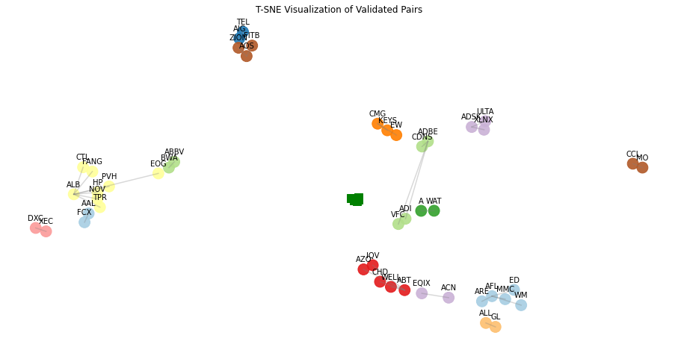

Slide 81
Conclusion
The clustering techniques do not directly help in stock trend prediction. However, they can be effectively used in portfolio construction for finding the right pairs, which eventually help in risk mitigation and one can achieve superior risk adjusted returns.

Slide 82
Conclusion
We showed the approaches to finding the appropriate number of clusters in k-means and built a hierarchy graph in hierarchical clustering. A next step from this case study would be to explore and backtest various long/short trading strategies with pairs of stocks from the groupings of stocks.

Slide 83
Conclusion
Clustering can effectively be used for dividing stocks into groups with “similar characteristics” for many other kinds of trading strategies and can help in portfolio construction to ensure we choose a universe of stocks with sufficient diversification between them.

